Slide 1


K.RAMAKRISHNAN COLLEGE OF TECHNOLOGY
(AUTONOMOUS), TRICHY.
E-HEALTH MANAGEMENT SYSTEM
PRESENTED
DHARANI D V
2303811710422028
SUPERVISOR
Mr. M. Saravanan, M.E.,
AP/CSE.

Slide 2
PRESENTATION OVERVIEW
Objective
Project Introduction
Problem Statement
Methodologies (Programming concepts relevant to problem statement)
Architecture of the proposed system
List of Modules
Merits
Results and Discussion
Queries

Slide 3
OBJECTIVE
The E-Health Management System is a Java-based application designed to streamline the management of patient records, appointment scheduling, and user authentication manually.

Slide 4
PROJECT INTRODUCTION
The E-Health Management System is a Java-based application developed to address the growing need for efficient healthcare management. In today's fast-paced world, hospitals and clinics face challenges in managing patient records, appointment scheduling, and user authentication manually.

Slide 5
PROBLEM STATEMENT
Healthcare systems often face significant challenges in managing patient records, scheduling appointments, and ensuring secure communication between healthcare providers and patients.
Traditional methods, which rely heavily on manual processes and fragmented systems, are prone to inefficiencies, errors, and data breaches.
These issues lead to delays in care, increased administrative burden, and dissatisfaction among both patients and medical staff.

Slide 6
METHODOLOGIES
Requirement Analysis: Identified stakeholder needs through interviews and surveys to define system features like patient management, appointment scheduling, and data security.
System Design: Utilized Java AWT and Jswing for GUI development.
Development Approach: Employed Object-Oriented Programming in Java with features like inheritance, encapsulation, and exception handling.
Technology Stack: Utilized Java Swing for GUI, ArrayLists for data management, and SimpleDateFormat for date validation.

Slide 7


ARCHITECTURE OF THE PROPOSED SYSTEM
Patient ID
Name
Age
Gender
Medical History
Start
Login successful!
Role: Patient
Enter Username
Enter password
1. View Patient Details
2. Book Appointment
3. View Appointments
4. Exit
Invalid Date Format
Invalid Credentials
1. Enter doctor’s name
2. Enter appt date
Home Page
Login
Create new User
Appointment successful!
1. Appt ID
2. Patient ID
3. Name
4. Doctor name
5. Date, day
Enter Username
Enter password
Role (admin/ staff/ patient)
Age
Gender
Enter Medical History
Account created successfully!
End

Slide 8
LIST OF MODULES
Manages patient records, including adding, viewing, and searching patient details like medical history, age, and gender.
MODULE DESCRIPTON
User management Module:
  Handles user roles (admin, staff, patients) with secure authentication, account creation, and role-based permissions.
Patient Management Module:
  Manages patient records, including adding, viewing, and searching patient details like medical history, age, and gender.
Appointment Management Module:
  Enables booking, viewing, and managing appointments linked to patients and doctors, ensuring date and detail accuracy.

Slide 9
LIST OF MODULES
Manages patient records, including adding, viewing, and searching patient details like medical history, age, and gender.
MODULE DESCRIPTON
4. User Interface Module (GUI):
Provides an intuitive graphical interface for users to interact with the system, including login, registration, and menu-based navigation.
5. Input Validation and Error Handling Module:
Validates user inputs (e.g., date formats, numeric values) and handles errors gracefully to maintain system integrity.

Slide 10
MERITS
User-Friendly Interface: A visually intuitive Java Swing-based GUI ensures smooth interaction for all user roles, enhancing user satisfaction.
Efficient Data Management: In-memory data handling using ArrayLists ensures quick and efficient retrieval and storage of patient and appointment records.
Error Handling and Validation: Comprehensive input validation and error prevention mechanisms improve system reliability and user trust.

Slide 11
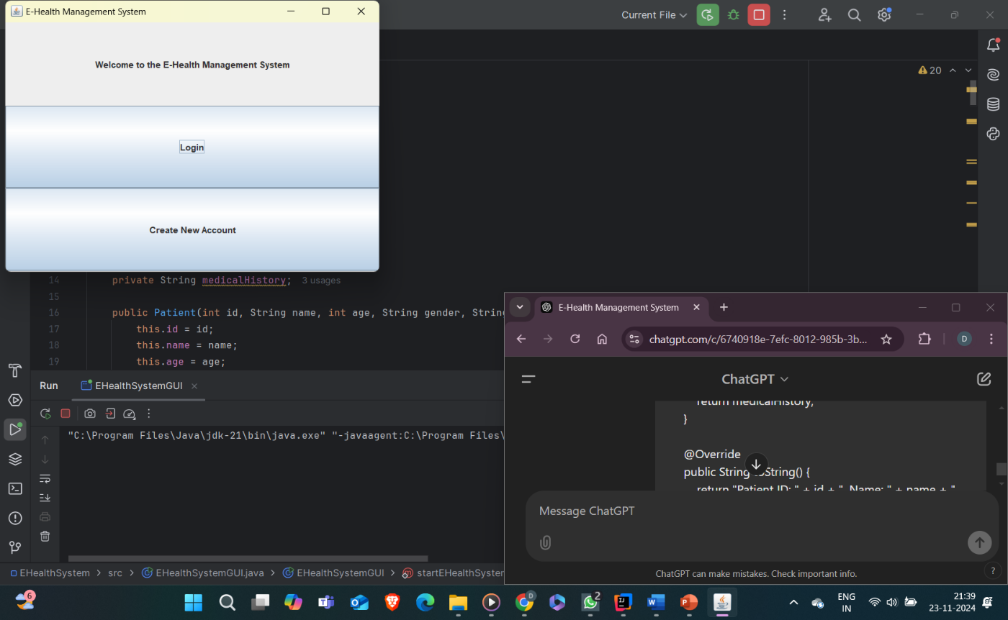
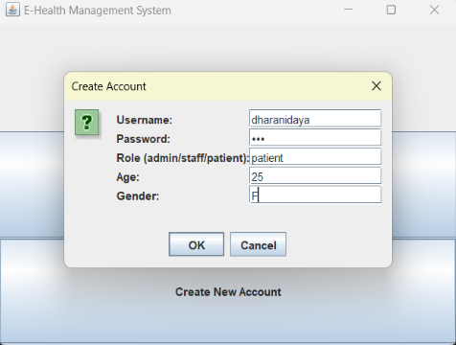
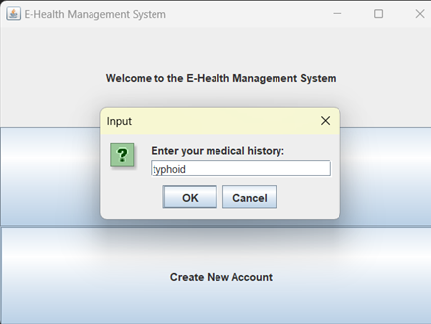
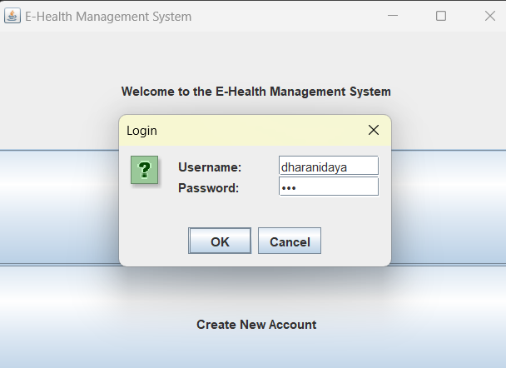
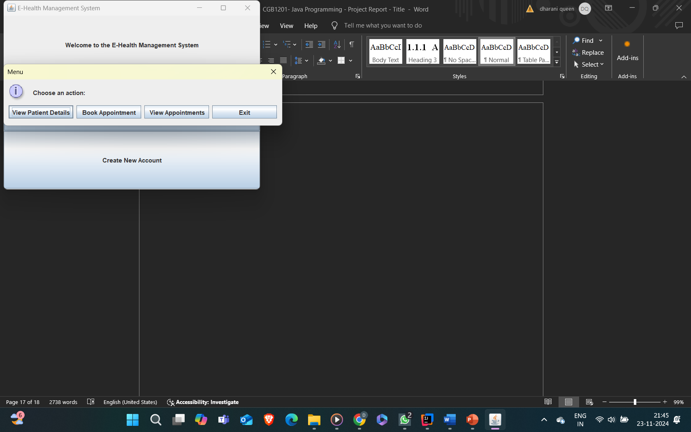
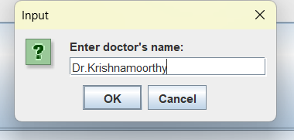
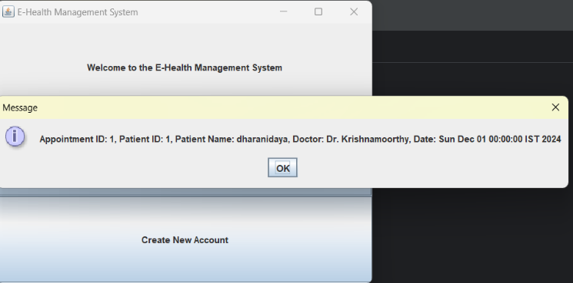

RESULTS AND DISCUSSION
Home page
Create account
Enter Medical history
Login
Menu
Appointment details
View Appointment details

Slide 12
QUERIES ?

